Slide 1
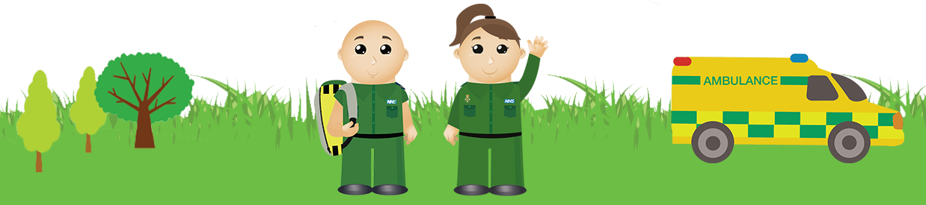
999 or not?
EYFS & KS1
999 is the number to call for the ambulance service when there is an emergency.
The ambulance service helps people who are very poorly or have been hurt.

Slide 2
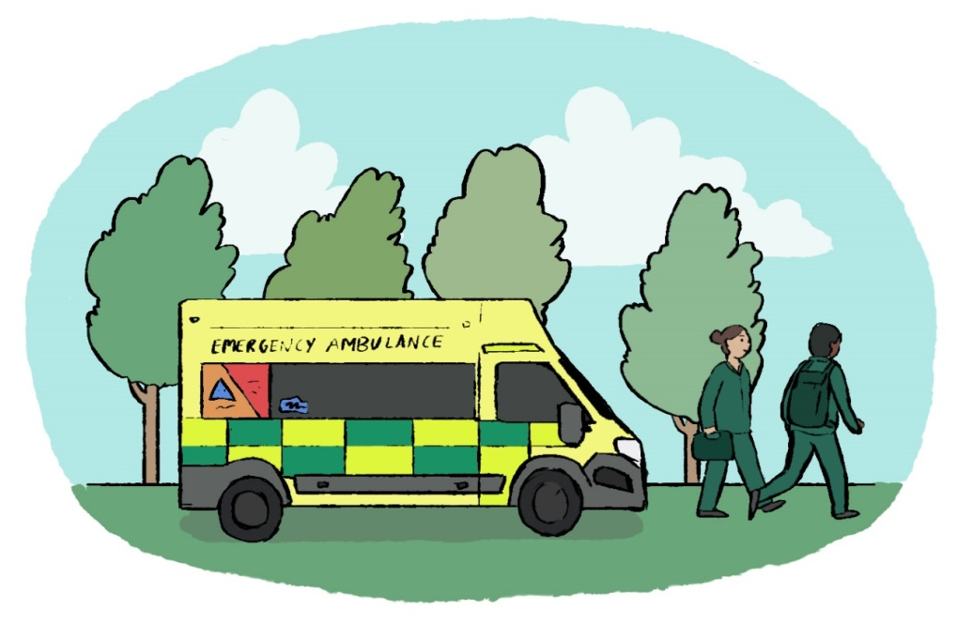
When should you call 999 ?
Call 999 for the emergency services – ambulance, fire, police and coastguard.
Ask for the ambulance service when someone is really poorly or badly hurt.
They may not be able to wake up, could be in a lot of pain or bleeding badly.

Slide 3
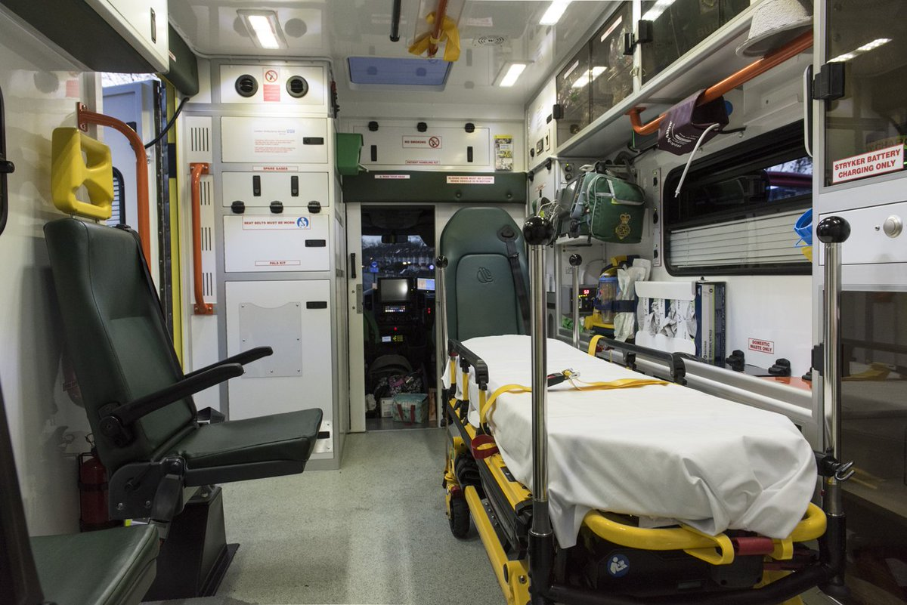
Inside an ambulance
Look at what is inside this ambulance. What can you see?

Slide 4
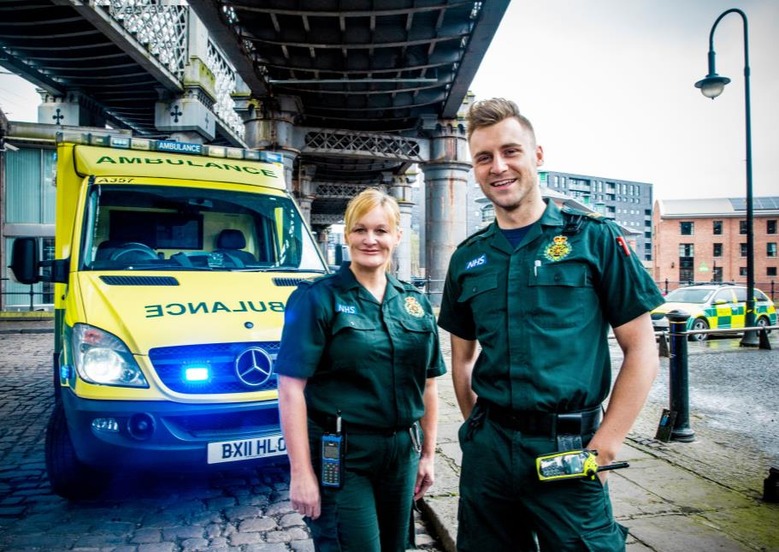
What do paramedics do?
Paramedics help people who are poorly or hurt. They work on an ambulance.
To get their help you must call 999. They have a lot of medicine and kit to treat you.
Once they have treated you they may take you to hospital or tell you on how to get better at home.

Slide 5
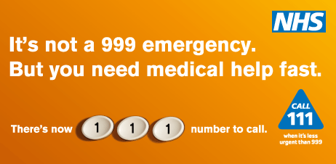
When should you call 111?
If you are unwell, the NHS 111 service will help you find the best place to make you feel better. They could send you to the doctors, pharmacy, dentist, walk-in centre or hospital. They may tell you how to take care of yourself at home.

Slide 6
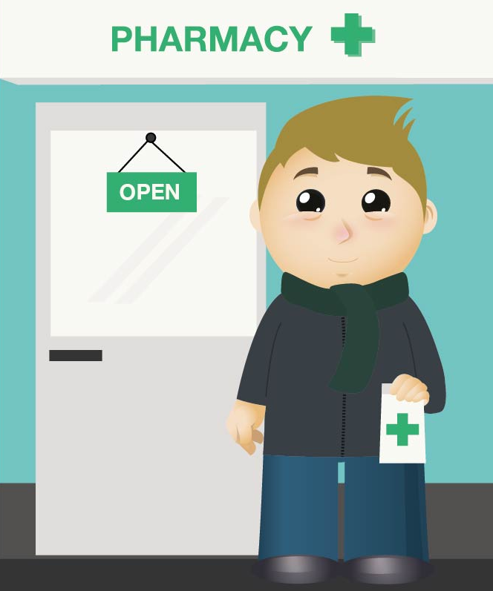
Why might you go to the pharmacy?
A pharmacist can give you medicines to make you feel better. They can also answer your questions when you are sick.

Slide 7
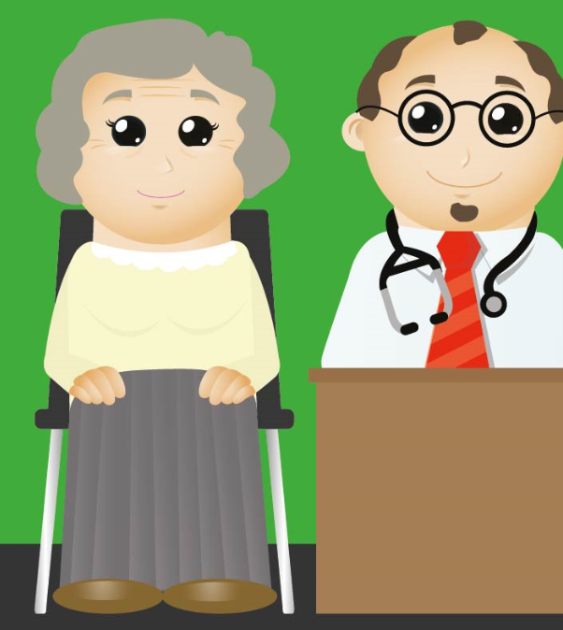
Why might you go to see a Doctor?
Doctors are there for you when you are not getting better from your minor illness.
They may arrange for you to have some medicine to make you better.

Slide 8

Fairy tale scenarios
Read the stories from Happily Ever After.
How many questions can you answer correctly?

Slide 9
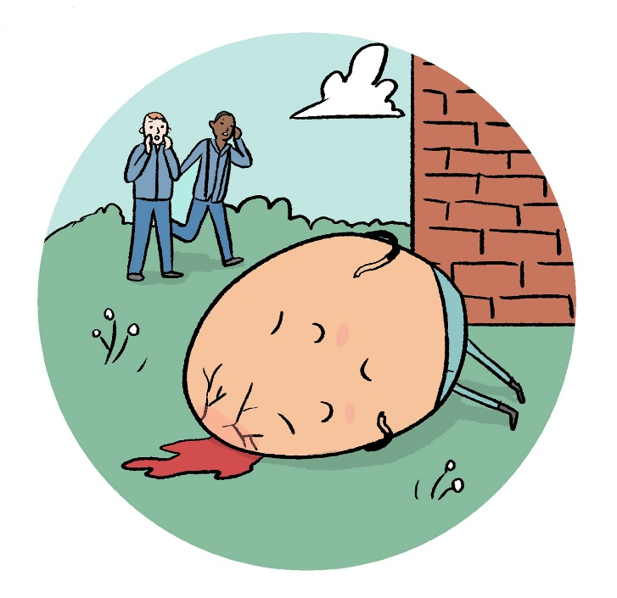
Uh oh …Humpty Dumpty is lying on the floor: he has bruised his head and there is a big crack. There’s blood pouring from it. What should the King’s men do?
A – ring 999
B – not sure ring 111
C – go home

Slide 10
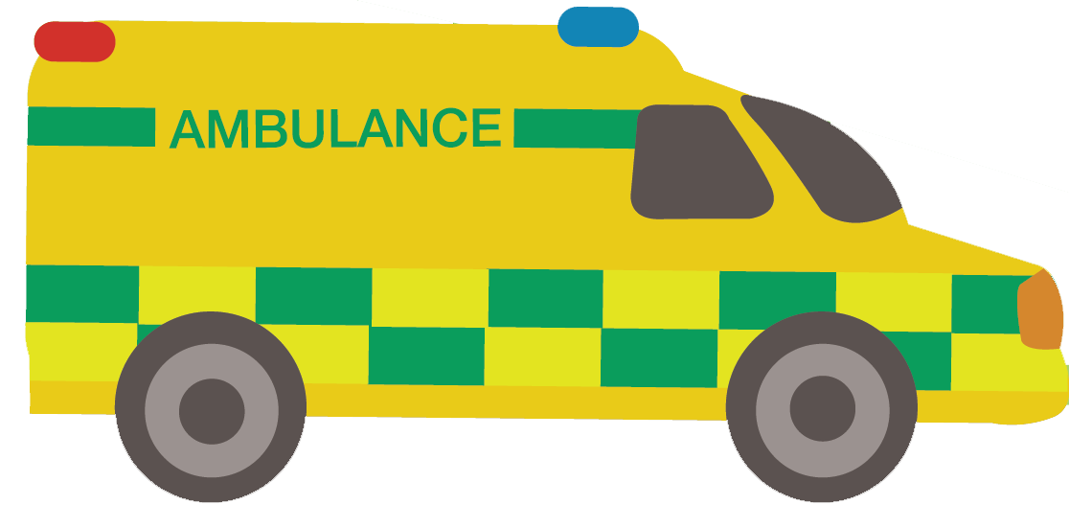
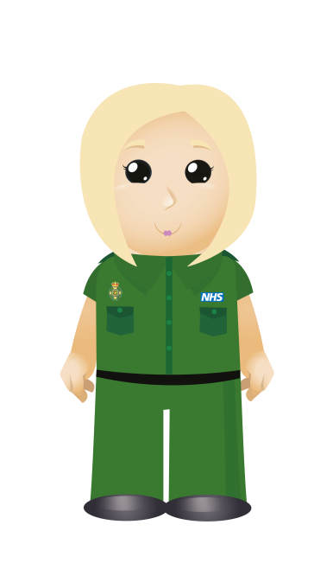
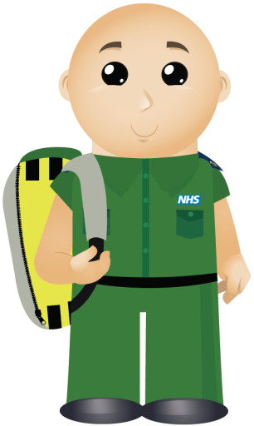
You are correct! Calling 999 was the right thing to do. Humpty Dumpty has a serious head injury and is losing lots of blood. Paramedics will come and make him feel better. They will take him to hospital in the ambulance.

Slide 11
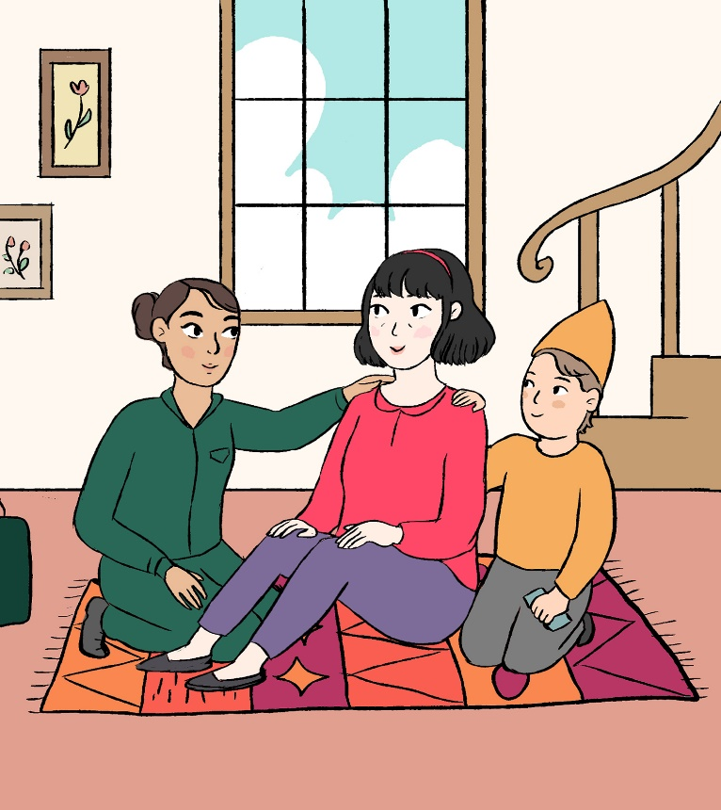
Sniffley has a cold and doesn’t want to spread his germs to his friends at work. He is coughing and sneezing. What should he do?
A – ring 999
B – not sure ring 111
C – go to the pharmacist for some medicine

Slide 12

You are correct! Going to the pharmacy for cold medicine is the best thing to do. Sniffley needs to rest at home and get better. This way he will not spread his germs to everyone else.

Slide 13
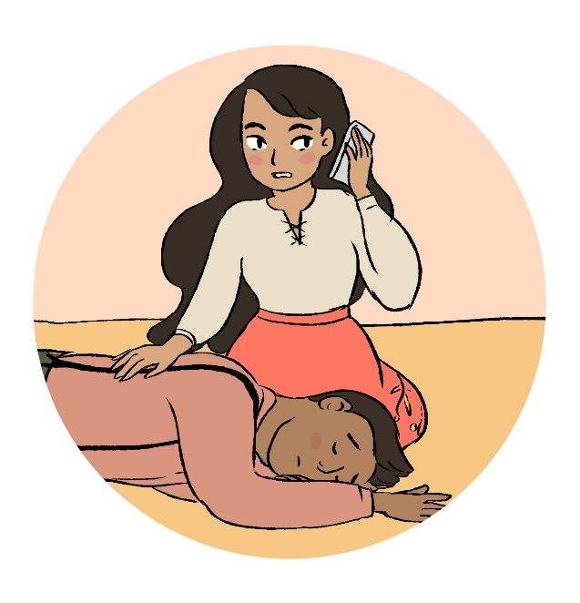
The handsome prince is very tired after rescuing Sleeping Beauty. This has caused him to have a seizure. Sleeping Beauty does not know what to do. What should she do?
A – ring 111
B – call 999
C – go to the pharmacist for some medicine

Slide 14
You are correct! Sleeping Beauty was not sure what to do so calling 111 for medical advice was the best thing to do.

Slide 15
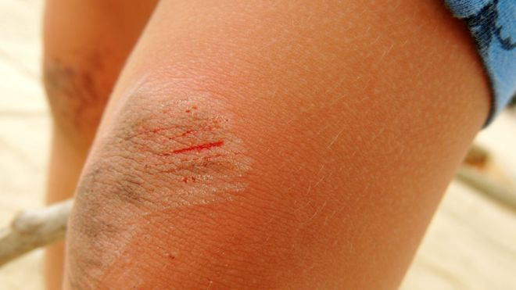
The Gingerbread man was running too fast. He has fallen and has grazed his knee and hands! What would you do?
A – find an adult to help him clean it and apply a plaster if needed
B – call 999
C – go to the Doctors
Photo credit: GETTY IMAGES

Slide 16
You are correct! Getting an adult to clean the graze with an antiseptic wipe will help the graze heal correctly. The gingerbread man doesn’t need to go to hospital. He will get better at home.

Slide 17
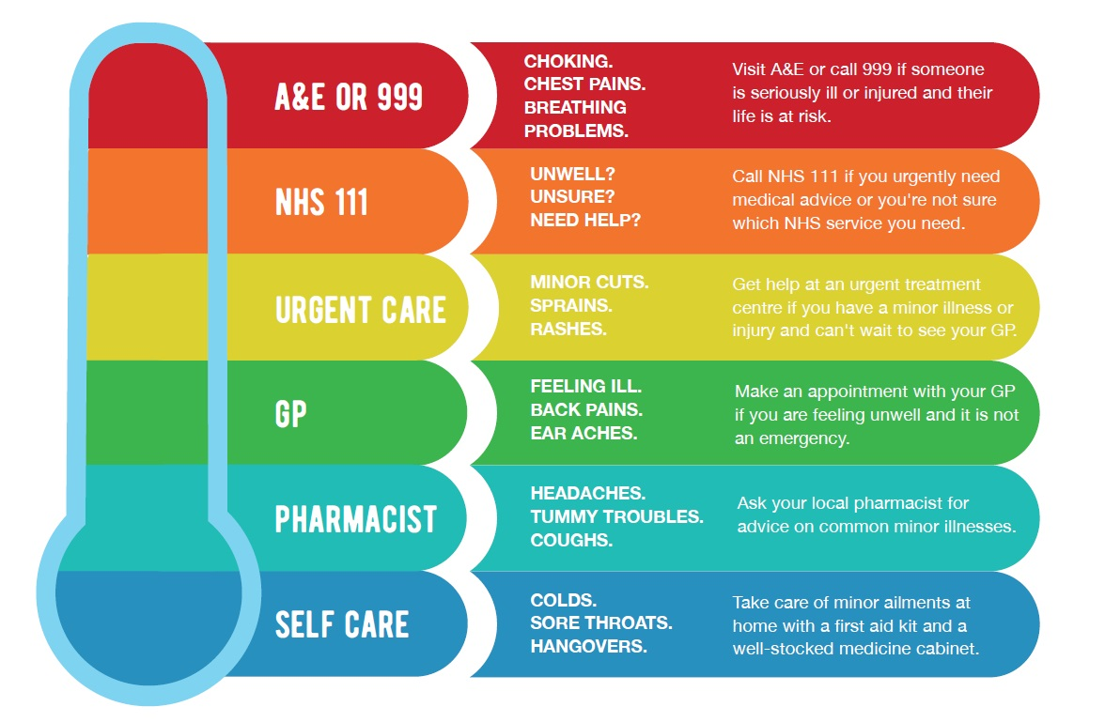
Where can you get help?

Slide 18
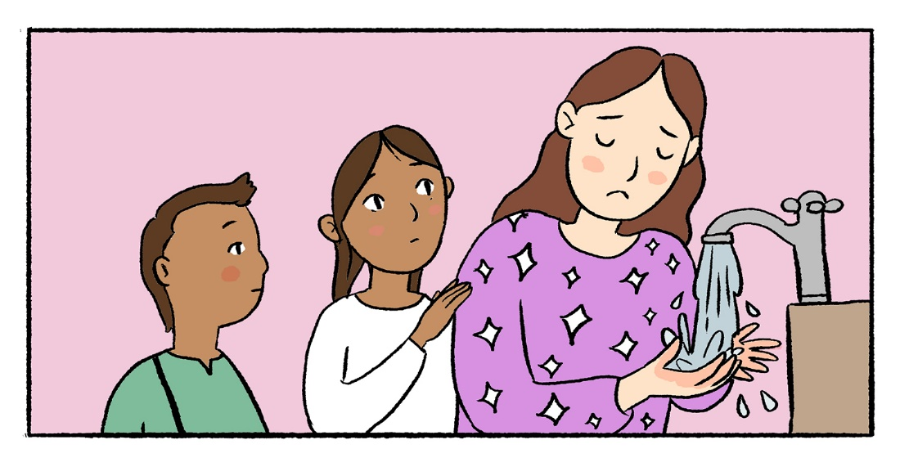
What to do in an emergency
stay calm.
find an adult to help you.
If there is no adult around, ring 999, explain what has happened and ask for the police, fire brigade, an ambulance or the coastguard.

Slide 19
www.nwas.nhs.uk

